Slide 1
Cypher Quering

Slide 2



Clauses of the Cypher language
MATCH
OPTIONAL MATCH
WHERE
WITH

Slide 3

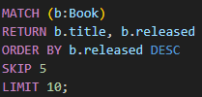


Clauses of the Cypher language
UNWIND
ORDER BY / SKIP / LIMIT
SET
DELETE / DETACH DELETE

Slide 4
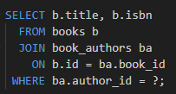
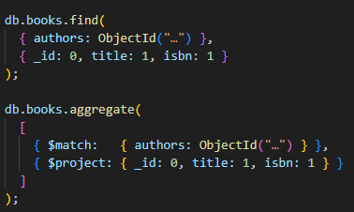
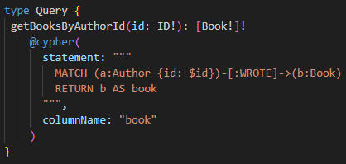
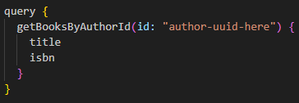
Comparing Selected Queries across Assignments
SQL
MongoDB
GraphQL/Neo4j

